Slide 1
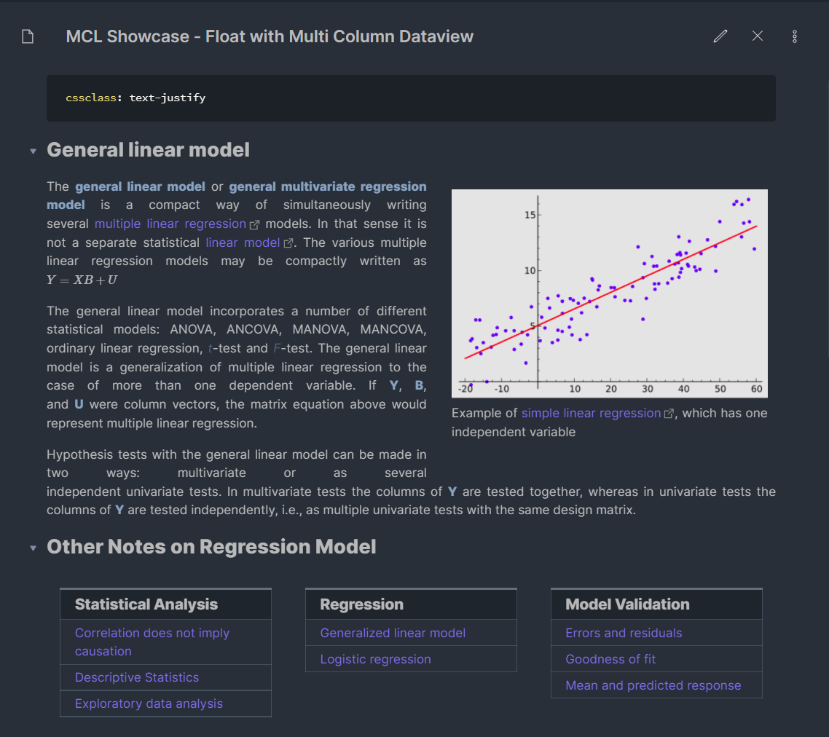
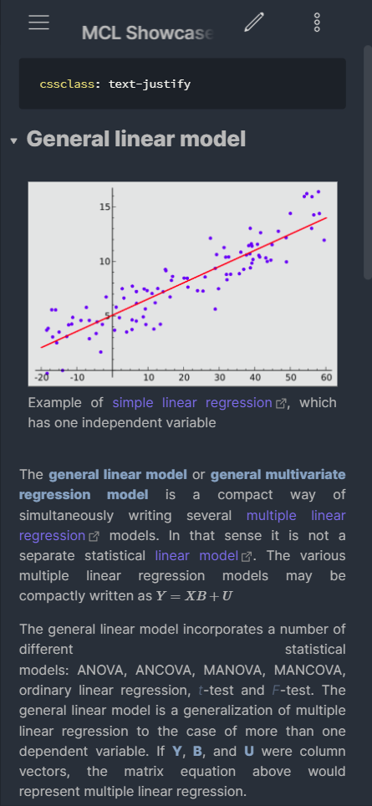
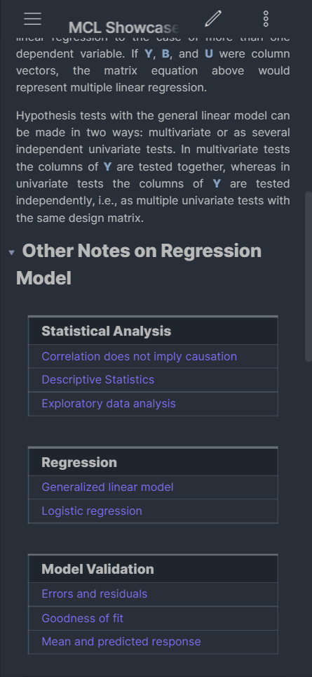

MCL Showcase – Float with Multi Column Dataview
Desktop App View
Mobile App View
Note: Using Mado 11 theme by hydescarf
https://github.com/efemkay/obsidian-modular-css-layout

Slide 2
Ever since callout (Sherlocked from Admonition plugin) become part of Obsidian core feature, many of us have more creative ways to structure our notes. But as Obsidian become more prominent and attract more users, not all are well-versed with CSS styling (while some prefer not to go down that rabbit hole 😄).
As such, I’ve created CSS snippet collection for layout which you can use with your many notes or just some. I try my best not to break any of the community theme (by focusing on layout i.e., using flex, grid and float). But of course, some of the themes’ devs are quite the magician, they might already have similar layout options.
I’ll be sharing showcases from time to time as I observe what OMG members want and what I can do.
Here’s my first showcase – creating a floating sidebar for sidenotes with multi column dataview (using callouts) for links to your related notes

